Slide 1
Labeling & Documentation
Sociology 365
Week 4
Spring 2022

Slide 2
Plan for the day
We’re using slides today because we’ll be going in and out of a few documents.
Exercise 1
Exercise 2
Mitchell Ch. 4
Long, Ch. 2 and related material
Project discussion

Slide 3
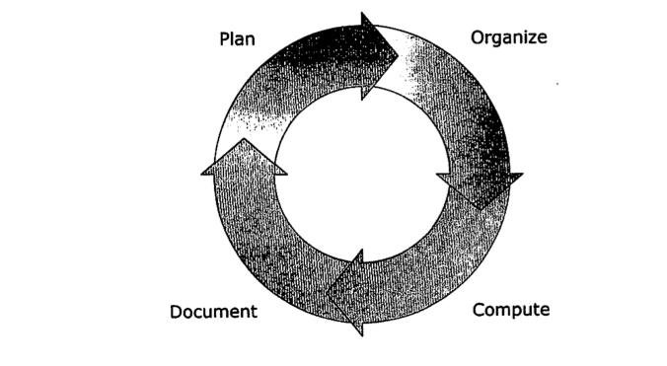
J. Scott Long. The Workflow of Data Analysis. Pp. 13

Slide 4
Long’s tips I
Main theme: you must plan, organize, and document (POD).
Things to consider while planning
Size of project
Scheduling
Size and duration
Division of labor/enforcer — ignore the unfortunate term
Data-sets
Variable-names and labels
Data collection/survey design
Missing data
Analysis
Documentation / archiving

Slide 5
Long’s tips II
Main theme: you must plan, organize, and document (POD).
Things to consider while organizing
Be smart about file-names; use appropriate characters and mnemonic names.
Use a good directory structure; what we’ve been doing so far in class (and what we saw at the end of the do-file) is a good guide.
Examples for larger projects follow. You should also have a master document that says where everything goes.

Slide 6
Long’s tips III
Main theme: you must plan, organize, document (POD). For documenting, think “sudden amnesia test”.
Things to consider while documenting
What to document (data sources, analysis, software)
The levels (research log chronicles everything you did; codebook keeps track of variables; you might need to have a registry of do-files and data-sets).
Two examples from me, one positive, one negative.
Positive: in my thesis, I spend pp. 48-63 laying out exactly where my data come from (many sources, lots of cleaning).
Negative: “COVID paper story”

Slide 7
The research log
A template (and other useful research material) is available at Long’s website.
The main idea is that such a log should…
have a plan for what your research will cover next
help you pick up where you’ve left off (in the real world, research is always interrupted)
help you replicate your work

Slide 8
Motivation for a research log: the importance of documenting logical flow across do-files
Most projects cannot be done in a single do file
You might have a set of do-files such as these:
one file for data extraction and labeling
one file for additional data cleaning and management
one file for basic descriptive work
one file for core analyses
one or more files for sensitivity analyses, supplemental analyses
It is essential that you can replicate whole process – starting with original data file
Notes:
Class projects are small and self-contained but that is obviously not the way things are done in real-world settings – projects are typically much longer in duration and much larger in scope, and much higher in terms of stakes.
Here’s an example about the last one – you are working for a client – organizing and analyzing data from customer satisfaction surveys or something like that – you have just about completed the project when the client says they have an updated file with 1000 new customers included – you have to be able to replicate everything that you have done on the original data file. Hopefully the format and variable names and structure for the new file will be the same as for the old file.

Slide 9
Create a system that works for you
Long presented you with a system
These slides reflect the system used by Christine Schwartz, the chair of the our Sociology Department.
You need to develop a system that works for you (and the requirements of your work)
Highly recommend “testing out” Schwartz’s or Long’s system for this class. Then you can assess if there are things you want to add or change going forward.

Slide 10
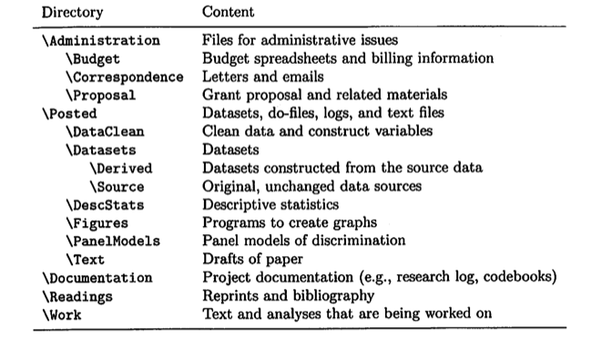
Example file structure
Notes:
Long’s file structure

Slide 11
Schwartz's system
/Projectname
/do
/documentation
/dta
/filecreation
/graphs
/presentations
/tabs and figs
/submission1
/submission2
/text
/submission1
/submission2

Slide 12
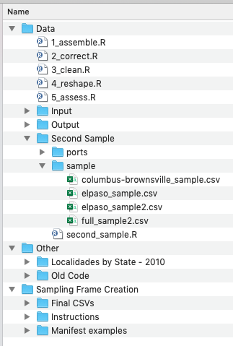
Example from Sarah Farr #1
“This is a screenshot of my file organization for a project I am working on with Prof. Jenna Nobles. In this case, we are creating a dataset based on scanned administrative records (no analysis).
Input: csv files needed to do some of the assembly and cleaning
Output: data files created at different steps in the process. Records to be re-entered, records yet to be entered, etc.
Second Sample: we realized that we forgot to sample from some boxes of files. So we had to make a ”second sample”. This folder contains all the files used to creates that second sample. The csv files created become “inputs”.

Slide 13
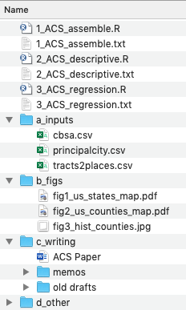
Example from Sarah Farr #2
“This is for a paper I’m working on with American Community Survey data. Note Similar file structure: inputs, outputs (“b_figs”), and a writing folder.
Note that in both this example and the last example, I have broken out my R Scripts (the equivalent of .do files in Stata) into several steps and labelled them accordingly.
Not perfection—I realize while prepping this lecture that I should create some master documentation files (like Prof. Schwartz does) to keep a record of, for example, where I got the “input” files from.”

Slide 14
Other ways to keep organized & efficient
“File flow”
Schwartz & Mare (2005) Demography documentation
https://www.ssc.wisc.edu/~cschwart/files_eamtrends.html
You will make & hand in one of these for your final projects

Slide 15
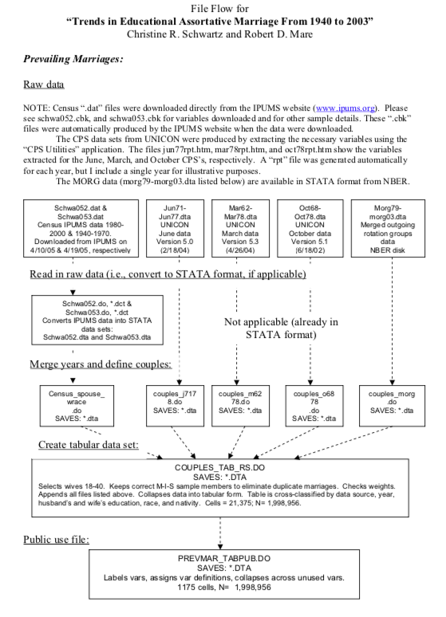
Christine Schwartz’s website
File flow from Prof. Schwartz’s website.
She walks you through how she went from the original data files to the final data files.
She also provides all of the .do files you need to replicate.
Recommend taking a look at her files. A good example to follow!

Slide 16
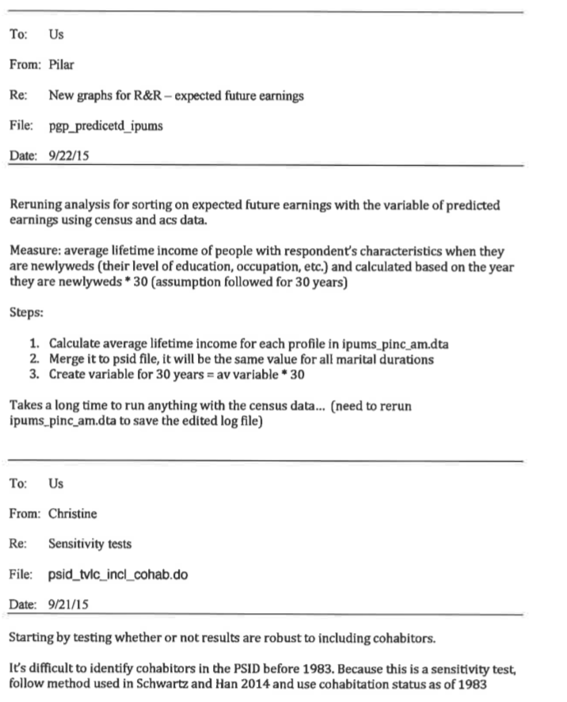
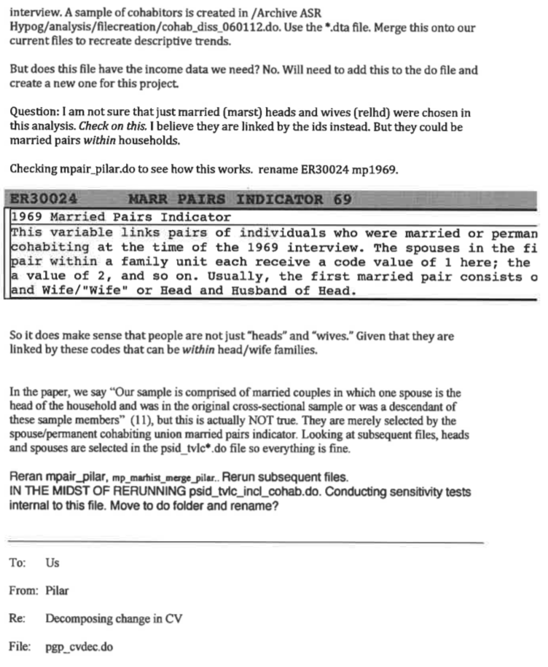
Example research log from Christine Schwartz and her collaborator

Slide 17
Organization tips/tricks
When dating files, use the “programmer’s friend” method of dating, which you see me use: YYYY-MM-DD.
Fun fact/real world example: I learned this from my friend Alexi Brooks in the CS department. We were managing some internal union data for the Teaching Assistants Association (AFT Local 3220); I asked him why he dated files this way, and he pointed out that it is because it makes it easy to sort by date if you only have a crude alphabetical sorter.
Stata actually is “smarter” than this, but if you have a folder on your computer and you can only sort by name, this will work.
You can make new folders from within Stata, as I’ve shown you; you can also make them using a command line on your computer, which is kind of fun — you’re more or less “doing computer science” at that point. Here’s a possible strategy.

Slide 18
Proposal (due 2022-02-28)
(1) What data set you’ll use.
(2) What difference between groups, change over time, and/or relationship/association you’re interested in investigating.
(3) What variables you think you’ll use to conduct your analysis.

Slide 19
Example I
I will use the 2016 General Social Survey
I am interested in gender differences in widowhood rates and how they vary by race/ethnicity
Are elderly Black, white, Asian, or Hispanic women more likely to be widows? How does this compare to the rates for men?
Variable names: widowed, age, sex, race, ethnic

Slide 20
Example II
I’m interested in using a wave of the NHANES data-set to examine the relationship between different indicators of metabolic syndrome.
I will use an average of the diastolic and systolic blood pressure measures.

Slide 21
This week
Complete Exercise 3
Main principle in data entry: Change data as little as possible. Create record of raw data. Can "clean" and "recode" in subsequent steps.
Read Mitchell, Chapter 5 (submit notes)
recoding, creating new variables
Submit proposal

